Slide 1
Reap-air Bot
Global Game Jam 2020

Slide 2
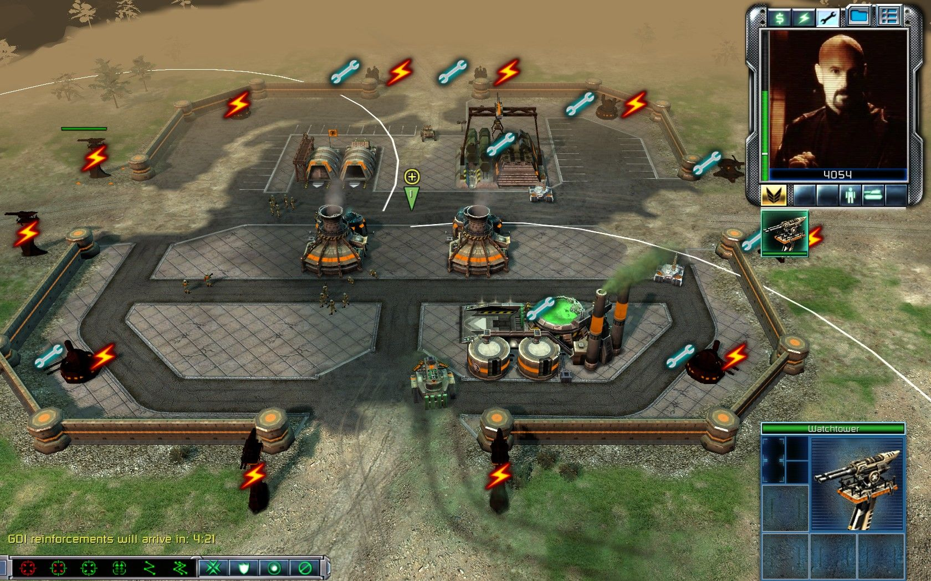
Description
The player is a robot engineer that repairs turrets, robots, and walls/barriers to survive from incoming waves of enemies.
The enemies are also robots that swarm the “base”.
(Optional)
An energy reactor could be present that powers the repaired structures (turrets, walls). When the number is passed, structures are disabled.

Slide 3
Player Experience
Repair Robot Engineer
Tactical approach to repairing
Under pressure

Slide 4
Core Mechanic
Survive in an arena by repairing other machines
NPC Robots
Static Turrets
Electric barriers/walls

Slide 5
Core Game Loop
Repair machines and structures to demolish incoming waves
The waves will destroy everything in their path to kill the player
Until death? Specific length of time? (TO BE DECIMATED)

Slide 6
Tech & Specs
Unity – C#
PC platform
Resolution 1920 x 1080
Aspect Ratio 16:9

Slide 7
Game Theme
Robots
Sci-fi
Space
Different Planet
PEW PEW!

Slide 8
Onion Design
CORE FEATURES
Player Movement
Structures and Machines
Repairing
Enemies
Somewhat intelligent behavior
BONUS FEATURES
Variants of enemies, structures, and machines

